Slide 1
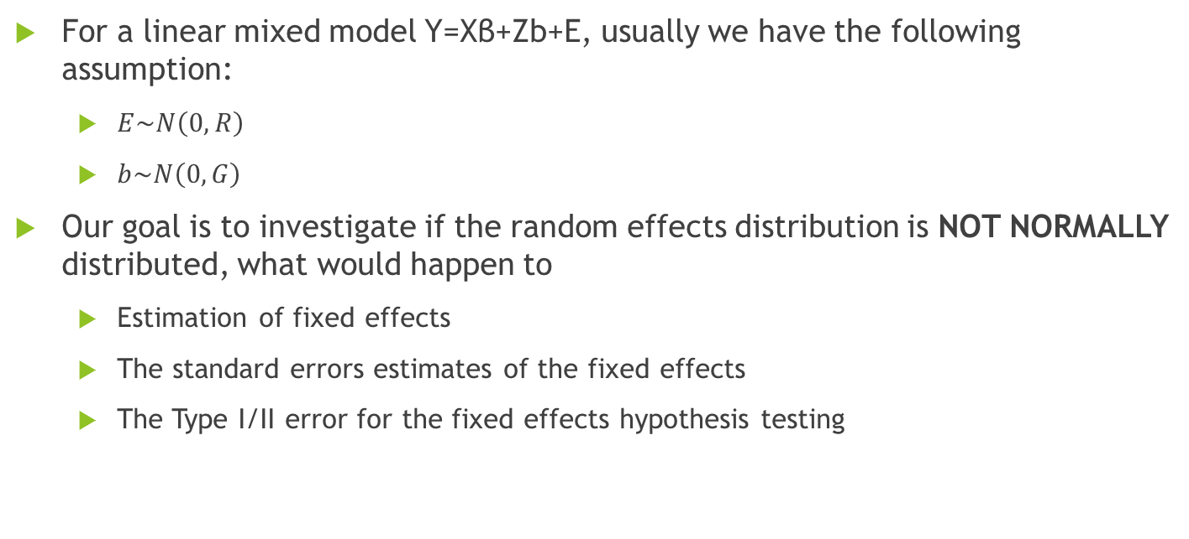
Project2 interim presentation: Linear mixed model with non-normal distribution of random components Speaker: Zhou,Wenru Group3 members: Zhang, Lingdi; Zhuang, Yaxu; Zhou, Wenru
For a linear mixed model Y=Xβ+Zb+E, usually we have the following assumption:
$E\sim N\left(0,R\right)$
$b\sim N\left(0,G\right)$
Our goal is to investigate if the random effects distribution is NOT NORMALLY distributed, what would happen to
Estimation of fixed effects
The standard errors estimates of the fixed effects
The Type I/II error for the fixed effects hypothesis testing

Slide 2
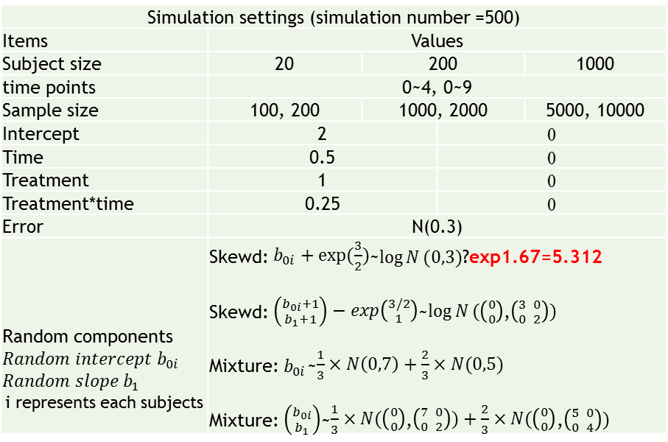
The case we would study
Simulation settings:
3 settings of subjects:
Number of subjects =20, 200, 1000
2 settings fixed components :
Treatment
Time (integers):
0 to 4
0 to 9
An interaction between time and treatment
2 kinds distribution:
Error: Independent and identically normal distribution
Random components:
Skewed: log normal distribution
Mixture: mixed two normal distribution
500 number of simulation for each setting
Analyses:
2 kinds linear mixed models:
Random intercept model
Random intercept and slope model
Simulation settings (simulation number =500)
Items | Values
Subject size | 20 | 200 |  | 1000
time points | 0~4, 0~9
Sample size | 100, 200 | 1000, 2000 |  | 5000, 10000
Intercept | 2 |  | 0
Time | 0.5 |  | 0
Treatment | 1 |  | 0
Treatment*time | 0.25 |  | 0
Error | N(0.3)
Random components $$Random intercept b_{0i}$$ $$Random slope b_{1}$$ i represents each subjects | Skewd: $b_{0i}+exp(\frac{3}{2})$~$\log{N}(0,3)$?exp1.67=5.312 Skewd: $\left({b_{0i}+1 \atop b_{1}+1}\right)−exp\left({3/2 \atop 1}\right)$~$\log{N}(\left({0 \atop 0}\right)$,$\left({3 \atop 0} {0 \atop 2}\right))$ Mixture: $b_{0i}$~$\frac{1}{3}×N\left(0,7\right)+\frac{2}{3}×N(0,5)$ Mixture: $\left({b_{0i} \atop b_{1}}\right)$~$\frac{1}{3}×N(\left({0 \atop 0}\right)$,$\left({7 \atop 0} {0 \atop 2}\right))+\frac{2}{3}×N(\left({0 \atop 0}\right)$,$\left({5 \atop 0} {0 \atop 4}\right))$
What scale?

Slide 3
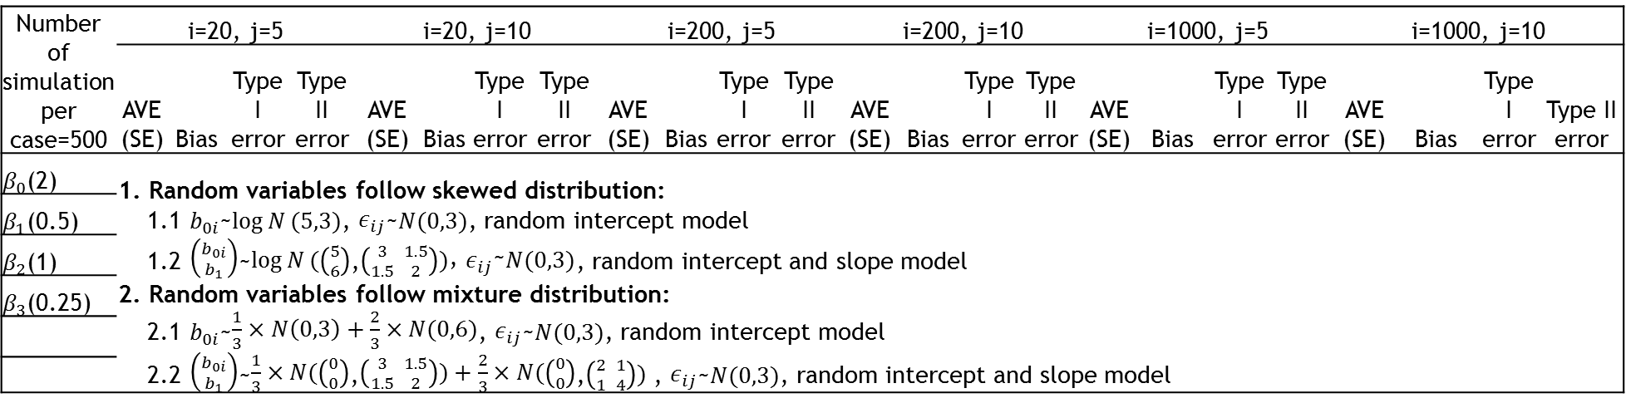
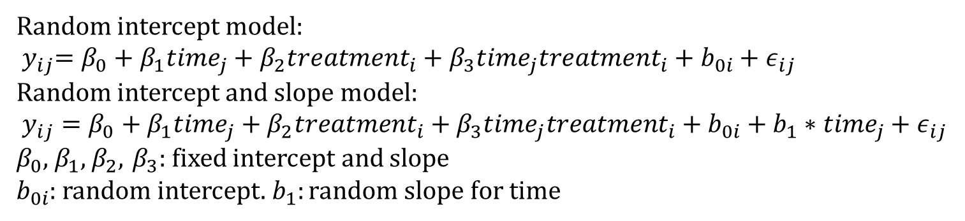
The parameters in the simulation
Random intercept model:
$${ y}_{ij}=β_{0}+β_{1}{time}_{j}+β_{2}{treatment}_{i}+β_{3}{time}_{j}{treatment}_{i}+b_{0i}+ε_{ij}$$
Random intercept and slope model:
$y_{ij}=β_{0}+β_{1}{time}_{j}+β_{2}{treatment}_{i}+β_{3}{time}_{j}{treatment}_{i}+b_{0i}+b_{1}∗{time}_{j}+ε_{ij}$
$β_{0}$, $β_{1}$, $β_{2}$, $β_{3}$: fixed intercept and slope
$b_{0i}$: random intercept. $b_{1}:random slope for time$
Number of simulation per case=500 | i=20, j=5 |  |  |  | i=20, j=10 |  |  |  | i=200, j=5 |  |  |  | i=200, j=10 |  |  |  | i=1000, j=5 |  |  |  | i=1000, j=10
 | AVE (SE) | Bias | Type I error | Type II error | AVE (SE) | Bias | Type I error | Type II error | AVE (SE) | Bias | Type I error | Type II error | AVE (SE) | Bias | Type I error | Type II error | AVE (SE) | Bias | Type I error | Type II error | AVE (SE) | Bias | Type I error | Type II error
$β_{0}$(2) | 1. Random variables follow skewed distribution: 1.1 $b_{0i}$~$\log{N}(5,3)$, $ε_{ij}$~$N(0,3)$, random intercept model 1.2 $\left({b_{0i} \atop b_{1}}\right)$~$\log{N}(\left({5 \atop 6}\right)$,$\left({3 \atop 1.5} {1.5 \atop 2}\right))\text{, }ε_{ij}\text{\sim }N(0,3)$, random intercept and slope model 2. Random variables follow mixture distribution: 2.1 $b_{0i}$~$\frac{1}{3}×N\left(0,3\right)+\frac{2}{3}×N(0,6)$, $ε_{ij}$~$N(0,3)$, random intercept model 2.2 $\left({b_{0i} \atop b_{1}}\right)$~$\frac{1}{3}×N(\left({0 \atop 0}\right)$,$\left({3 \atop 1.5} {1.5 \atop 2}\right))+\frac{2}{3}×N(\left({0 \atop 0}\right)$,$\left({2 \atop 1} {1 \atop 4}\right))$ , $ε_{ij}$~$N(0,3)$, random intercept and slope model
$β_{1}$(0.5)
$β_{2}$(1)
$β_{3}$(0.25)

Slide 4
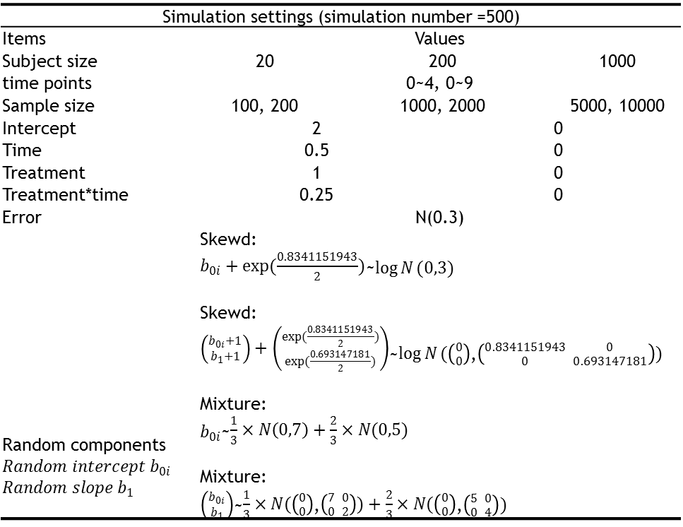
Simulation settings (simulation number =500)
Items | Values
Subject size | 20 | 200 |  | 1000
time points | 0~4, 0~9
Sample size | 100, 200 | 1000, 2000 |  | 5000, 10000
Intercept | 2 |  | 0
Time | 0.5 |  | 0
Treatment | 1 |  | 0
Treatment*time | 0.25 |  | 0
Error | N(0.3)
Random components $$Random intercept b_{0i}$$ $$Random slope b_{1}$$ | Skewd: $b_{0i}+exp(\frac{0.8341151943}{2})$~$\log{N}(0,3)$ Skewd: $\left({b_{0i}+1 \atop b_{1}+1}\right)+\left({exp(\frac{0.8341151943}{2}) \atop exp(\frac{0.693147181}{2})}\right)$~$\log{N}(\left({0 \atop 0}\right)$,$\left({0.8341151943 \atop 0} {0 \atop 0.693147181}\right))$ Mixture: $b_{0i}$~$\frac{1}{3}×N\left(0,7\right)+\frac{2}{3}×N(0,5)$ Mixture: $\left({b_{0i} \atop b_{1}}\right)$~$\frac{1}{3}×N(\left({0 \atop 0}\right)$,$\left({7 \atop 0} {0 \atop 2}\right))+\frac{2}{3}×N(\left({0 \atop 0}\right)$,$\left({5 \atop 0} {0 \atop 4}\right))$

Slide 5
Table 2.1 Simulation results (Subject=20)
Subject=20 | Coefficients=0(time=5) |  |  |  |  | Coefficients ≠0(time=5) |  |  |  |  | Coefficients=0(time=10) |  |  |  |  | Coefficients ≠0(time=10)
Run=500 | Est | SD | SE | Bias | Type I error | Est | SD | SE | Bias | Type II error | Est | SD | SE | Bias | Type I error | Est | SD | SE | Bias | Type II error
Random: intercept
Skewed distribution
Intercept | 0.022 | 0.687 | 0.031 | 0.022 | 0.058 | 2.022 | 0.687 | 0.031 | 0.022 | 0.098 | 0.008 | 0.656 | 0.029 | 0.008 | 0.058 | 2.008 | 0.656 | 0.029 | 0.008 | 0.054
Treatment | -0.039 | 0.972 | 0.043 | -0.039 | 0.056 | 0.961 | 0.972 | 0.043 | -0.039 | 0.786 | 0.004 | 0.921 | 0.041 | 0.004 | 0.060 | 1.004 | 0.921 | 0.041 | 0.004 | 0.712
Time | -0.013 | 0.168 | 0.008 | -0.013 | 0.052 | 0.487 | 0.168 | 0.008 | -0.013 | 0.198 | -0.001 | 0.060 | 0.003 | -0.001 | 0.046 | 0.499 | 0.060 | 0.003 | -0.001 | 0
Interaction | 0.024 | 0.236 | 0.011 | 0.024 | 0.046 | 0.274 | 0.236 | 0.011 | 0.024 | 0.780 | -0.002 | 0.085 | 0.004 | -0.002 | 0.048 | 0.248 | 0.085 | 0.004 | -0.002 | 0.180
Random: intercept
Mixture distribution
Intercept | 0.021 | 0.625 | 0.028 | 0.021 | 0.054 | 2.021 | 0.625 | 0.028 | 0.021 | 0.126 | 0.007 | 0.586 | 0.026 | 0.007 | 0.068 | 2.007 | 0.586 | 0.026 | 0.007 | 0.074
Treatment | 0.003 | 0.895 | 0.040 | 0.003 | 0.054 | 1.003 | 0.895 | 0.040 | 0.003 | 0.786 | 0.046 | 0.833 | 0.037 | 0.046 | 0.070 | 1.046 | 0.833 | 0.037 | 0.046 | 0.732
Time | -0.013 | 0.168 | 0.008 | -0.013 | 0.050 | 0.487 | 0.168 | 0.008 | -0.013 | 0.198 | -0.001 | 0.060 | 0.003 | -0.001 | 0.046 | 0.499 | 0.060 | 0.003 | -0.001 | 0
Interaction | 0.024 | 0.236 | 0.011 | 0.024 | 0.046 | 0.274 | 0.236 | 0.011 | 0.024 | 0.780 | -0.002 | 0.085 | 0.004 | -0.002 | 0.048 | 0.248 | 0.085 | 0.004 | -0.002 | 0.180
Random: intercept, time
Skewed distribution
Intercept | 0.016 | 0.679 | 0.030 | 0.016 | 0.056 | 2.016 | 0.679 | 0.030 | 0.016 | 0.106 | 0.009 | 0.640 | 0.029 | 0.009 | 0.066 | 2.009 | 0.640 | 0.029 | 0.009 | 0.060
Treatment | -0.011 | 0.990 | 0.044 | -0.011 | 0.060 | 0.989 | 0.990 | 0.044 | -0.011 | 0.778 | 0.004 | 0.905 | 0.040 | 0.004 | 0.054 | 1.004 | 0.905 | 0.040 | 0.004 | 0.672
Time | 0.015 | 0.499 | 0.022 | 0.015 | 0.074 | 0.515 | 0.499 | 0.022 | 0.015 | 0.808 | 0.027 | 0.479 | 0.021 | 0.027 | 0.072 | 0.527 | 0.479 | 0.021 | 0.027 | 0.794
Interaction | -0.016 | 0.735 | 0.033 | -0.016 | 0.068 | 0.234 | 0.735 | 0.033 | -0.016 | 0.918 | -0.034 | 0.697 | 0.031 | -0.034 | 0.066 | 0.216 | 0.697 | 0.031 | -0.034 | 0.900
Random: intercept, time
Mixture distribution
Intercept | 0.008 | 0.638 | 0.029 | 0.008 | 0.070 | 2.008 | 0.638 | 0.029 | 0.008 | 0.128 | 0.0003 | 0.571 | 0.026 | 0.0003 | 0.058 | 2.000 | 0.571 | 0.026 | 0.0003 | 0.078
Treatment | -0.002 | 0.927 | 0.041 | -0.002 | 0.068 | 0.998 | 0.927 | 0.041 | -0.002 | 0.790 | 0.012 | 0.803 | 0.036 | 0.012 | 0.062 | 1.012 | 0.803 | 0.036 | 0.012 | 0.722
Time | -0.017 | 0.470 | 0.021 | -0.017 | 0.068 | 0.483 | 0.470 | 0.021 | -0.017 | 0.790 | -0.005 | 0.439 | 0.020 | -0.005 | 0.076 | 0.495 | 0.439 | 0.020 | -0.005 | 0.772
Interaction | 0.006 | 0.653 | 0.029 | 0.006 | 0.070 | 0.256 | 0.653 | 0.029 | 0.006 | 0.910 | -0.012 | 0.605 | 0.027 | -0.012 | 0.054 | 0.238 | 0.605 | 0.027 | -0.012 | 0.906

Slide 6
Table 2.2 Simulation results (Subject=200)
Subject=200 | Coefficients=0(time=5) |  |  |  |  | Coefficients ≠0(time=5) |  |  |  |  | Coefficients=0(time=10) |  |  |  |  | Coefficients ≠0(time=10)
Run=500 | Est | SD | SE | Bias | Type I error | Est | SD | SE | Bias | Type II error | Est | SD | SE | Bias | Type I error | Est | SD | SE | Bias | Type II error
Random: intercept
Skewed distribution
Intercept | 0.007 | 0.206 | 0.009 | 0.007 | 0.042 | 2.007 | 0.206 | 0.009 | 0.007 | 0 | 0.004 | 0.199 | 0.009 | 0.004 | 0.064 | 2.004 | 0.199 | 0.009 | 0.004 | 0
Treatment | -0.009 | 0.314 | 0.014 | -0.009 | 0.056 | 0.991 | 0.314 | 0.014 | -0.009 | 0.104 | 0.001 | 0.285 | 0.013 | 0.001 | 0.052 | 1.001 | 0.285 | 0.013 | 0.001 | 0.072
Time | -0.001 | 0.051 | 0.002 | -0.001 | 0.032 | 0.499 | 0.051 | 0.002 | -0.001 | 0 | -0.0001 | 0.020 | 0.001 | -0.0001 | 0.062 | 0.500 | 0.020 | 0.001 | -0.0001 | 0
Interaction | 0.002 | 0.076 | 0.003 | 0.002 | 0.046 | 0.252 | 0.076 | 0.003 | 0.002 | 0.08 | -0.001 | 0.028 | 0.001 | -0.001 | 0.056 | 0.249 | 0.028 | 0.001 | -0.001 | 0
Random: intercept
Mixture distribution
Intercept | 0.012 | 0.197 | 0.009 | 0.012 | 0.036 | 2.012 | 0.197 | 0.009 | 0.012 | 0 | 0.009 | 0.187 | 0.008 | 0.009 | 0.064 | 2.009 | 0.187 | 0.008 | 0.009 | 0
Treatment | -0.019 | 0.289 | 0.013 | -0.019 | 0.064 | 0.981 | 0.289 | 0.013 | -0.019 | 0.08 | -0.009 | 0.266 | 0.012 | -0.009 | 0.054 | 0.991 | 0.266 | 0.012 | -0.009 | 0.044
Time | -0.001 | 0.051 | 0.002 | -0.001 | 0.032 | 0.499 | 0.051 | 0.002 | -0.001 | 0 | -0.0001 | 0.020 | 0.001 | 0.000 | 0.062 | 0.500 | 0.020 | 0.001 | -0.0001 | 0
Interaction | 0.002 | 0.076 | 0.003 | 0.002 | 0.046 | 0.252 | 0.076 | 0.003 | 0.002 | 0.08 | -0.001 | 0.028 | 0.001 | -0.001 | 0.056 | 0.249 | 0.028 | 0.001 | -0.001 | 0
Random: intercept, time
Skewed distribution
Intercept | 0.019 | 0.209 | 0.009 | 0.019 | 0.042 | 2.019 | 0.209 | 0.009 | 0.019 | 0 | -0.002 | 0.195 | 0.009 | -0.002 | 0.05 | 1.998 | 0.195 | 0.009 | -0.002 | 0
Treatment | -0.026 | 0.306 | 0.014 | -0.026 | 0.05 | 0.974 | 0.306 | 0.014 | -0.026 | 0.128 | 0.007 | 0.285 | 0.013 | 0.007 | 0.048 | 1.007 | 0.285 | 0.013 | 0.007 | 0.07
Time | -0.002 | 0.144 | 0.006 | -0.002 | 0.04 | 0.498 | 0.144 | 0.006 | -0.002 | 0.038 | 0.004 | 0.139 | 0.006 | 0.004 | 0.052 | 0.504 | 0.139 | 0.006 | 0.004 | 0.02
Interaction | 0.001 | 0.204 | 0.009 | 0.001 | 0.038 | 0.251 | 0.204 | 0.009 | 0.001 | 0.782 | -0.009 | 0.196 | 0.009 | -0.009 | 0.042 | 0.241 | 0.196 | 0.009 | -0.009 | 0.76
Random: intercept, time
Mixture distribution
Intercept | 0.021 | 0.214 | 0.010 | 0.021 | 0.058 | 2.021 | 0.214 | 0.010 | 0.021 | 0 | 0.000 | 0.189 | 0.008 | 0.000 | 0.054 | 2.000 | 0.189 | 0.008 | 0.0004 | 0
Treatment | -0.031 | 0.293 | 0.013 | -0.031 | 0.06 | 0.969 | 0.293 | 0.013 | -0.031 | 0.074 | 0.003 | 0.256 | 0.011 | 0.003 | 0.046 | 1.003 | 0.256 | 0.011 | 0.003 | 0.024
Time | -0.005 | 0.147 | 0.007 | -0.005 | 0.052 | 0.495 | 0.147 | 0.007 | -0.005 | 0.086 | 0.001 | 0.140 | 0.006 | 0.001 | 0.056 | 0.501 | 0.140 | 0.006 | 0.001 | 0.052
Interaction | -0.002 | 0.195 | 0.009 | -0.002 | 0.026 | 0.248 | 0.195 | 0.009 | -0.002 | 0.77 | -0.012 | 0.187 | 0.008 | -0.012 | 0.04 | 0.238 | 0.187 | 0.008 | -0.012 | 0.762

Slide 7
Table 2.3 Simulation results (Subject=1000)
Subject=1000 | Coefficients=0(time=5) |  |  |  |  | Coefficients ≠0(time=5) |  |  |  |  | Coefficients=0(time=10) |  |  |  |  | Coefficients ≠0(time=10)
Run=500 | Est | SD | SE | Bias | Type I error | Est | SD | SE | Bias | Type II error | Est | SD | SE | Bias | Type I error | Est | SD | SE | Bias | Type II error
Random: intercept
Skewed distribution
Intercept | -0.002 | 0.093 | 0.004 | -0.002 | 0.040 | 1.998 | 0.093 | 0.004 | -0.002 | 0 | -0.004 | 0.086 | 0.004 | -0.004 | 0.046 | 1.996 | 0.086 | 0.004 | -0.004 | 0
Treatment | 0.001 | 0.132 | 0.006 | 0.001 | 0.052 | 1.001 | 0.132 | 0.006 | 0.001 | 0 | 0.004 | 0.120 | 0.005 | 0.004 | 0.032 | 1.004 | 0.120 | 0.005 | 0.004 | 0
Time | -0.001 | 0.024 | 0.001 | -0.001 | 0.040 | 0.499 | 0.024 | 0.001 | -0.001 | 0 | 0.0003 | 0.008 | 0.0004 | 0.0003 | 0.04 | 0.500 | 0.008 | 0.0004 | 0.0003 | 0
Interaction | 0.002 | 0.034 | 0.002 | 0.002 | 0.048 | 0.252 | 0.034 | 0.002 | 0.002 | 0 | -0.0001 | 0.012 | 0.001 | -0.0001 | 0.032 | 0.250 | 0.012 | 0.0005 | -0.0001 | 0
Random: intercept
Mixture distribution
Intercept | -0.005 | 0.090 | 0.004 | -0.005 | 0.042 | 1.995 | 0.090 | 0.004 | -0.005 | 0 | -0.007 | 0.081 | 0.004 | -0.007 | 0.06 | 1.993 | 0.081 | 0.004 | -0.007 | 0
Treatment | 0.001 | 0.133 | 0.006 | 0.001 | 0.048 | 1.001 | 0.133 | 0.006 | 0.001 | 0 | 0.005 | 0.114 | 0.005 | 0.005 | 0.046 | 1.005 | 0.114 | 0.005 | 0.005 | 0
Time | -0.001 | 0.024 | 0.001 | -0.001 | 0.04 | 0.499 | 0.024 | 0.001 | -0.001 | 0 | 0.0003 | 0.008 | 0.0004 | 0.0003 | 0.04 | 0.500 | 0.008 | 0.0004 | 0.0003 | 0
Interaction | 0.002 | 0.034 | 0.002 | 0.002 | 0.048 | 0.252 | 0.034 | 0.002 | 0.002 | 0 | -0.0001 | 0.012 | 0.001 | -0.0001 | 0.032 | 0.250 | 0.012 | 0.001 | -0.0001 | 0
Random: intercept, time
Skewed distribution
Intercept | -0.003 | 0.096 | 0.004 | -0.003 | 0.050 | 1.997 | 0.096 | 0.004 | -0.003 | 0 | -0.003 | 0.088 | 0.004 | -0.003 | 0.046 | 1.997 | 0.088 | 0.004 | -0.003 | 0
Treatment | 0.0003 | 0.137 | 0.006 | 0.0003 | 0.052 | 1.000 | 0.137 | 0.006 | 0.0003 | 0 | 0.003 | 0.123 | 0.005 | 0.003 | 0.042 | 1.003 | 0.123 | 0.005 | 0.003 | 0
Time | 0.002 | 0.065 | 0.003 | 0.002 | 0.036 | 0.502 | 0.065 | 0.003 | 0.002 | 0 | 0.002 | 0.060 | 0.003 | 0.002 | 0.042 | 0.502 | 0.060 | 0.003 | 0.002 | 0
Interaction | 0.00002 | 0.092 | 0.004 | 0.00002 | 0.052 | 0.250 | 0.092 | 0.004 | 0.000 | 0.242 | -0.0004 | 0.086 | 0.004 | -0.0004 | 0.050 | 0.250 | 0.086 | 0.004 | -0.0004 | 0.196
Random: intercept, time
Mixture distribution
Intercept | -0.006 | 0.086 | 0.004 | -0.006 | 0.038 | 1.994 | 0.086 | 0.004 | -0.006 | 0 | -0.007 | 0.080 | 0.004 | -0.007 | 0.042 | 1.993 | 0.080 | 0.004 | -0.007 | 0
Treatment | 0.001 | 0.129 | 0.006 | 0.001 | 0.064 | 1.001 | 0.129 | 0.006 | 0.001 | 0 | 0.003 | 0.115 | 0.005 | 0.003 | 0.052 | 1.003 | 0.115 | 0.005 | 0.003 | 0
Time | -0.004 | 0.066 | 0.003 | -0.004 | 0.050 | 0.496 | 0.066 | 0.003 | -0.004 | 0 | -0.004 | 0.062 | 0.003 | -0.004 | 0.058 | 0.496 | 0.062 | 0.003 | -0.004 | 0
Interaction | 0.005 | 0.088 | 0.004 | 0.005 | 0.040 | 0.255 | 0.088 | 0.004 | 0.005 | 0.202 | 0.005 | 0.084 | 0.004 | 0.005 | 0.042 | 0.255 | 0.084 | 0.004 | 0.005 | 0.154

